Slide 1
By:
Olawale Oladiran
Impact of Remote Work on Employee Mental Well-Being
We explore patterns in mental health, stress, social isolation, and employee satisfaction.
Dataset
5,000 employees globally.
Context
Global HR workforce patterns.
Objective
Identify areas needing HR support.

Slide 2

OVERVIEW
What Does the Data Tell Us?
5,000
76.1%
33.7%
3.0/5
33.5%
Total Employees
Mental Health Condition
High Stress Rate
Avg Social Isolation
Remote Satisfaction
Mental health struggles are high across the board. Affecting over 75% of employees, the data proves this is an organization-wide crisis, not just a remote work problem.

Slide 3



WORK LOCATIONS
Mental Health Patterns Are Similar Across Work Locations
Mental Health Condition Rate by Location
Onsite
Reported mental health condition rates are consistently high across all three work arrangements, with only modest differences.
Hybrid
Remote
"The data does not support concluding that remote work itself causes poorer mental health."

Slide 4



Reported Primary Condition Types
CONDITION BREAKDOWN
Burnout, Anxiety, and Depression Are the Main Reported Conditions
Burnout
Anxiety
Depression
Mental health concerns are distributed across several major condition categories, suggesting the need for broad employee well-being support.
None

Slide 5
ADDITIONAL DRIVERS
Stress and Social Isolation Show Limited Differences
Stress profiles are very similar across work arrangements, while social isolation shows some variation but not a perfectly linear relationship.
Stress Profile by Work Location
Mental Health Condition Rate by Isolation Rating (1-5)
Location | High Stress | Med Stress | Low Stress
Remote | 34.4% | 33.7% | 31.9%
Hybrid | 34.0% | 33.1% | 32.9%
Onsite | 32.7% | 33.4% | 33.9%
74.5%
75.6%
76.4%
77.4%
76.4%
1
2
3
4
5

Slide 6
WORK-LIFE BALANCE
Work-Life Balance Shows a Similar Pattern
Mental health condition rates remain consistently high across work-life balance ratings, reinforcing that no single factor explains the overall pattern.
75.2%
77.0%
76.3%
76.7%
75.2%
Rating 1
Rating 2
Rating 3
Rating 4
Rating 5

Slide 7

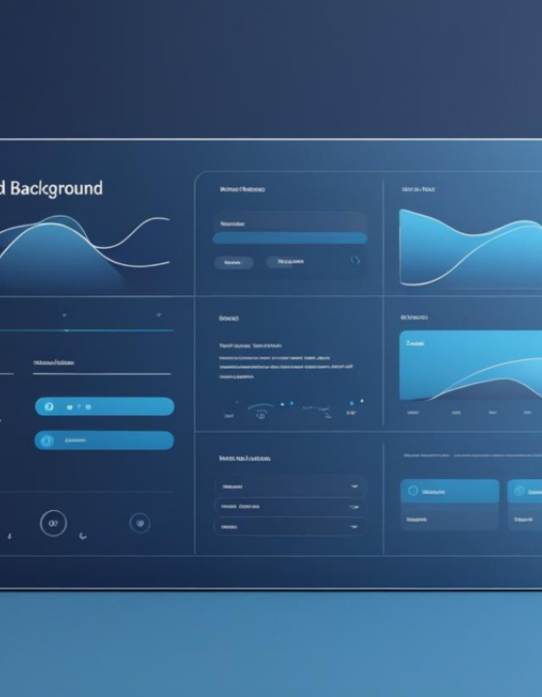
DASHBOARD CAPABILITY
Identify Priority Employee Segments
HR teams can interactively filter the dashboard to identify segments with higher mental health condition rates, higher stress, greater isolation, or lower satisfaction.
Work Location
Region
Industry
Job Role
Age Group
Gender

Slide 8



RECOMMENDATIONS
From Insights to Action
Avoid a one-size-fits-all work model
Strengthen proactive mental health support
Target interventions using segmentation
"Work arrangement alone does not explain mental health patterns."
"High reported condition and stress rates indicate the importance of accessible and preventative employee support."
"Use region, industry, role, demographic and work-arrangement filters to identify higher-priority employee groups."

Slide 9
KEY TAKEAWAY
"Employee mental well-being cannot be explained by work arrangement alone."
Mental health condition rates are high across remote, hybrid, and onsite employees.
Stress profiles are broadly similar across work arrangements.
Multiple factors must be evaluated together.
Interactive segmentation identifies where support is most needed.
From measuring employee well-being to making more targeted, evidence-based HR decisions.

Slide 10
Thank You.

